Slide 1
North Lake Tahoe-Truckee
Leadership Program
2019 Action Plan | HitchTahoe
Nicole Lutkemuller
Ashley White
Mark Jacobson
Sarah Ring
Holly Atkins

Slide 2
Why HitchTahoe?

Slide 3
HitchTahoe
Hop in.
Hop out.
Share rides.

Slide 4
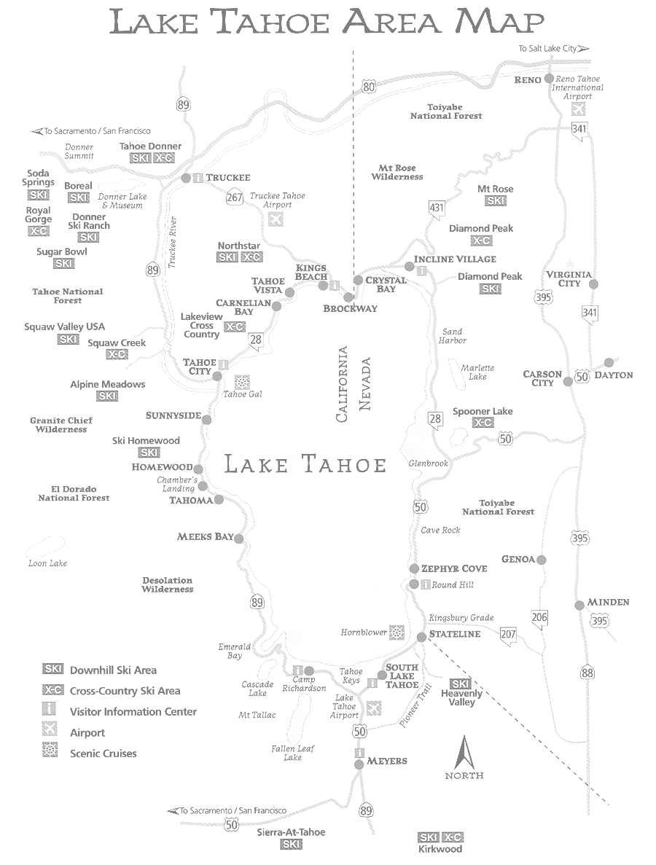
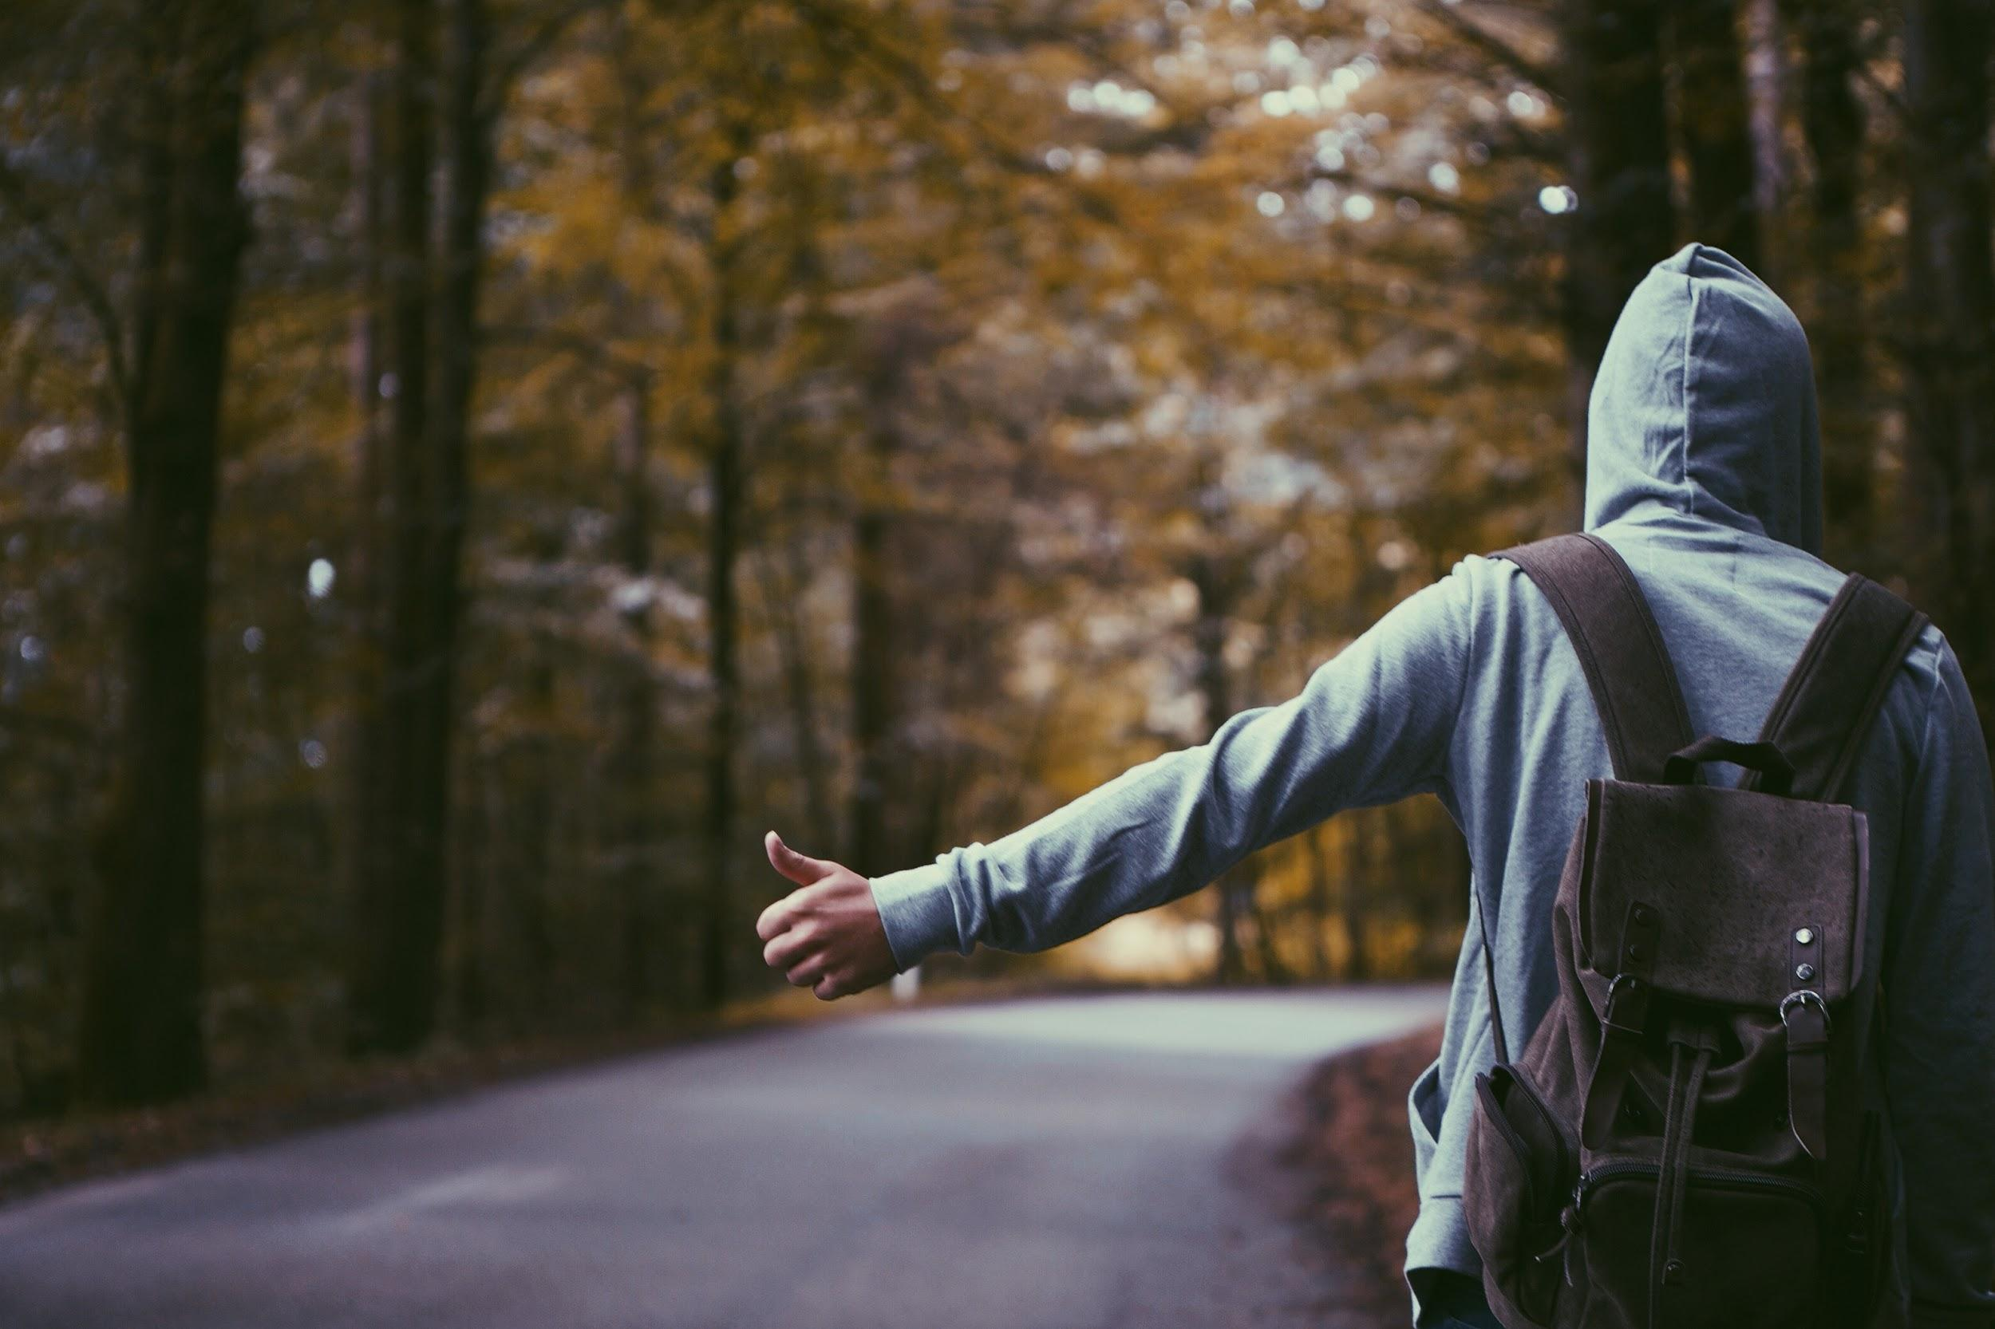
We are riders.

Slide 5
Fun, adventurous and working adults
Travelers and visitors alike
Community members in need
Local and exchange students
Event go-getters

Slide 6
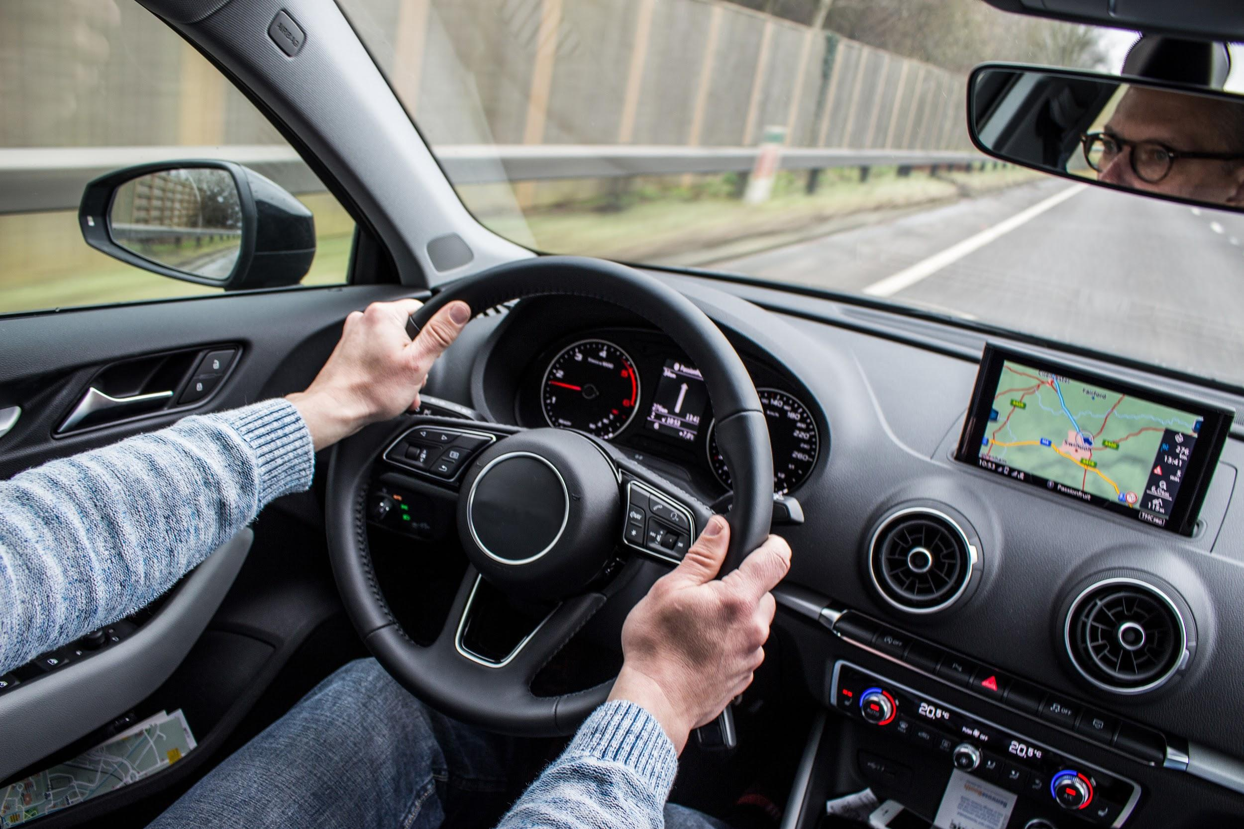
We are drivers.

Slide 7
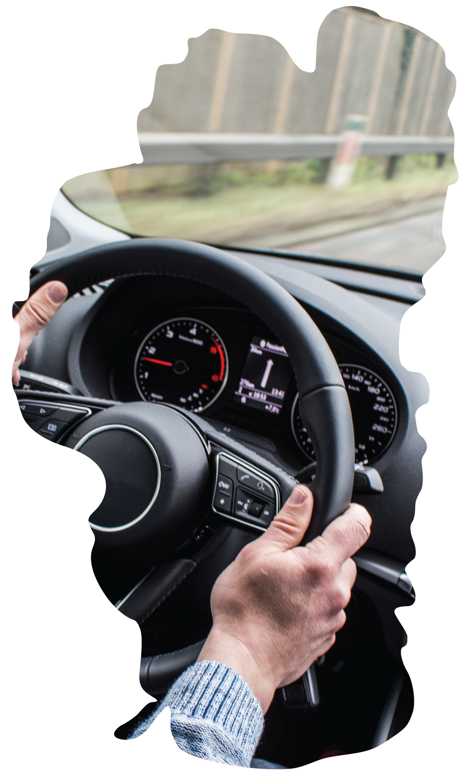
Responsible neighbors with car room
Trusting and friendly atmosphere
Those who plan ahead
Community driven attitudes
Get around fast and easy

Slide 8
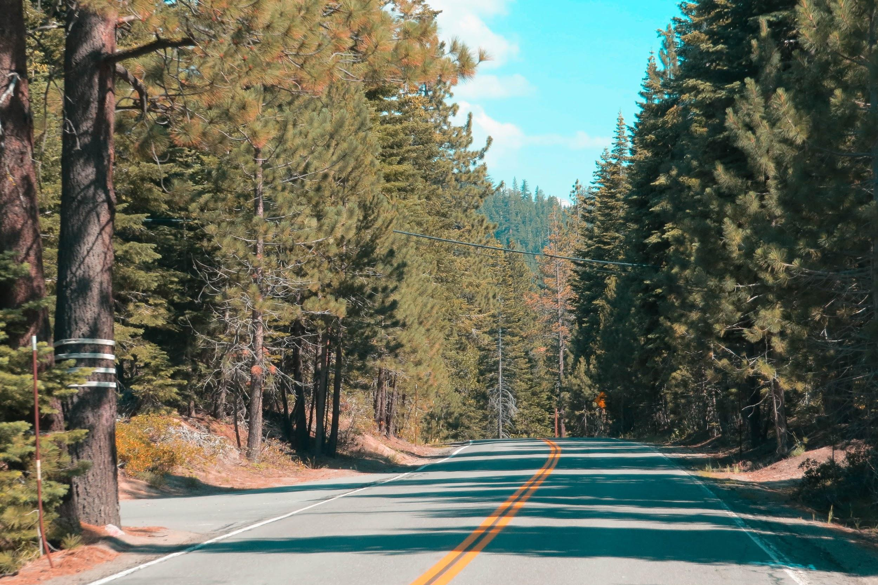
We make impacts.

Slide 9
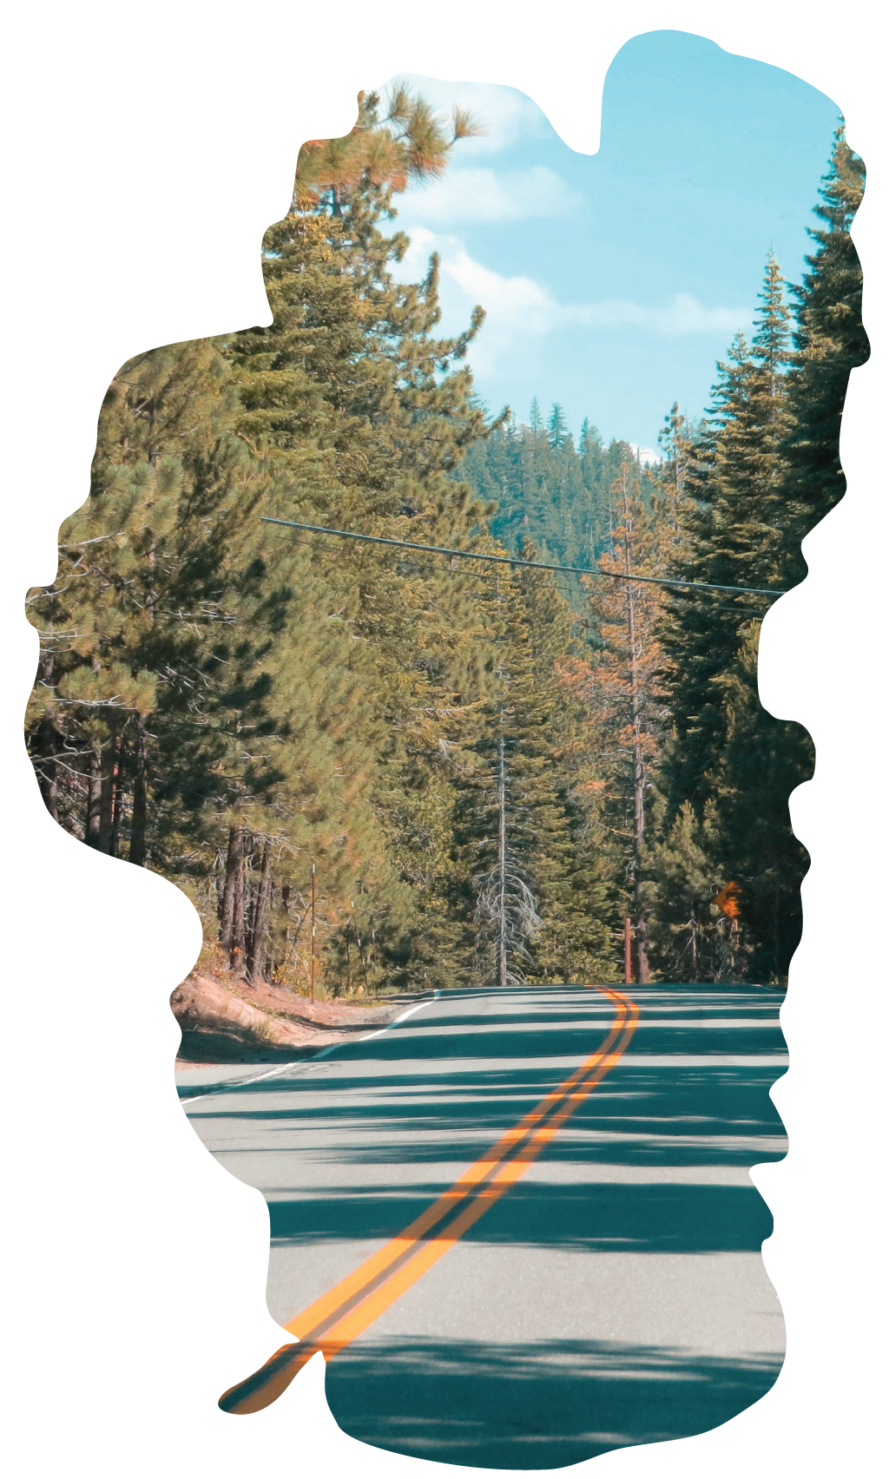
Minimize single-driver cars on the road
Reduce greenhouse gas emissions
Create impactful state-of-minds
Reliability is a core value
Simply connect

Slide 10
Most importantly...

Slide 11
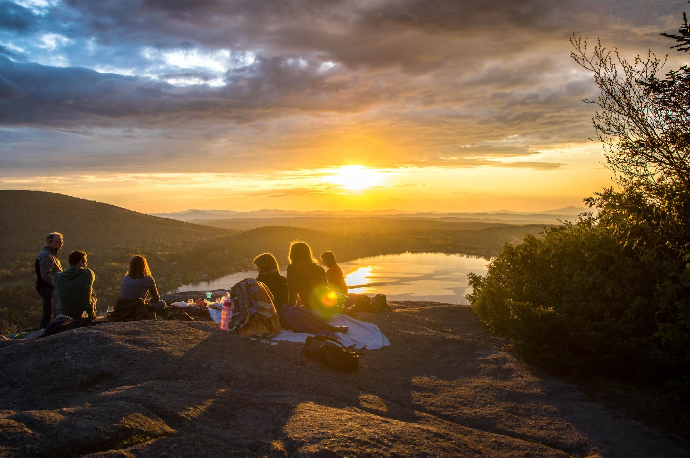
We are a community.

Slide 12
HitchTahoe surveyed 50+ community members...

Slide 13
43% would use the HitchTahoe app as both a rider and driver
As a potential driver:
71% incentivized to reduce traffic and greenhouse gas emissions
58% want to be conscientious community members
45% use the app several times per month
35% want to earn share ride credits
As a potential rider:
75% feel secure with a personal profile and rating system
73% feel secure with a provided first and last name
65% use the HitchTahoe app several times per month
52% feel secure knowing the driver’s age

Slide 14
HitchTahoe is free for everyone, but...

Slide 15
Funding is an essential part for any and all businesses to “lift” off
Types of funding resources include:
Crowdfunding
Private Investors and Donors
Grant Funding
Individual resources include:
Placer County (CA) and Washoe County (NV)
North Lake Tahoe Resort Association
Truckee Tahoe Resort Transportation Association
Town of Truckee
Tahoe Regional Planning Agency
Crystal Bay Club and Tahoe Biltmore

Slide 16
Marketing is more than just a buzzword...

Slide 17
Marketing is about the story we are telling.
Marketing Outlets:
Print/Online (Moonshine, Tahoe Weekly, Reno News & Review..)
Festivals (Truckee Thursdays, Wanderlust, WinterWonderGrass..)
Events (Music on the Beach, Concerts at Commons..)
Farmers Markets (Truckee, Tahoe City, South Lake Tahoe..)
Human Resource Departments (Squaw Valley, Northstar..)
Chamber Mixers
Promotional “Shwag”:
Chapstick > Car Fresheners > Dashboard Phone Holder > Stickers
Pocket-Sized Ice Scraper > Carabiner > Travel Beer Opener > Etc.

Slide 18
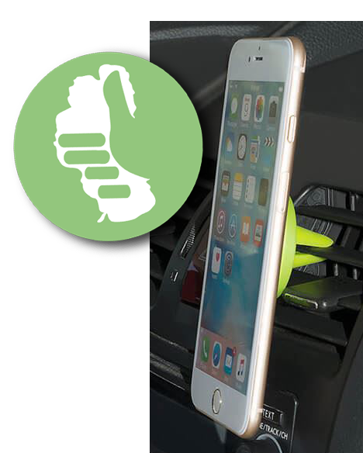
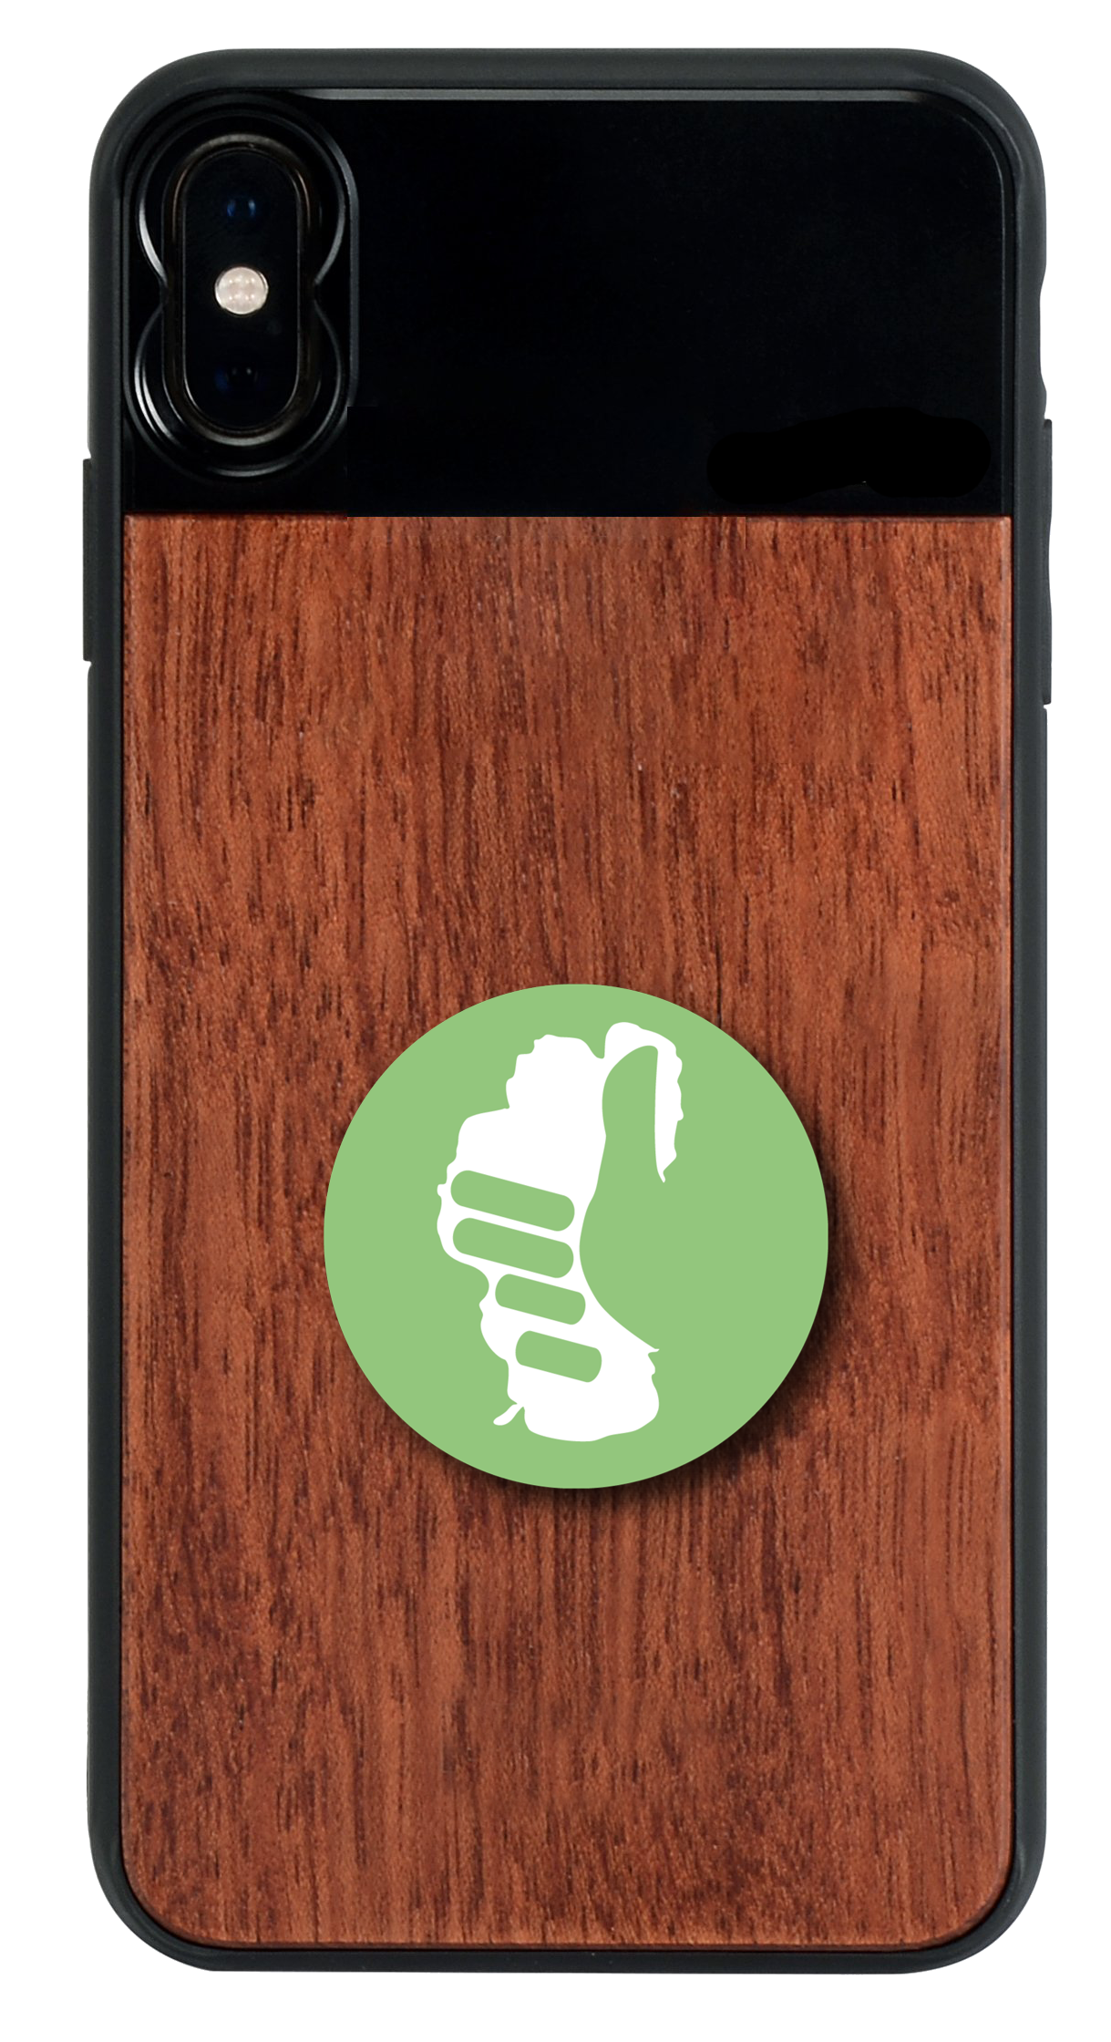
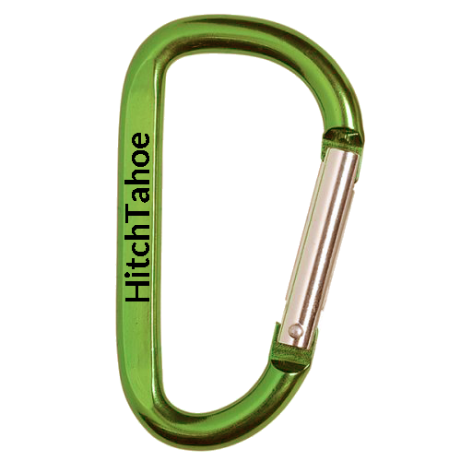
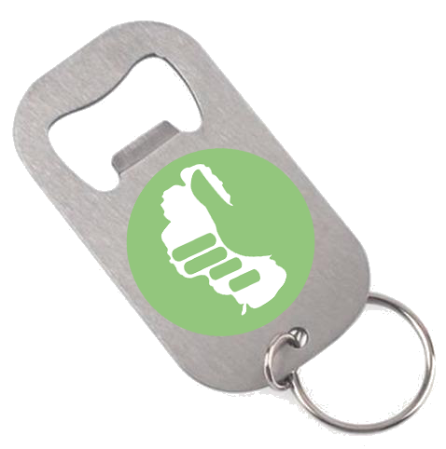

Slide 19
“The sharing economy is uniquely placed to reflect our desire as human beings to connect directly and to feel a part of community larger than our individual selves…”
Rachel Botsman, Trust Fellow: Oxford University

Slide 20
HitchTahoe
A fun, easy and free rideshare app designed to create
carpooling opportunities between riders and drivers
for the Lake Tahoe region.

