Slide 1
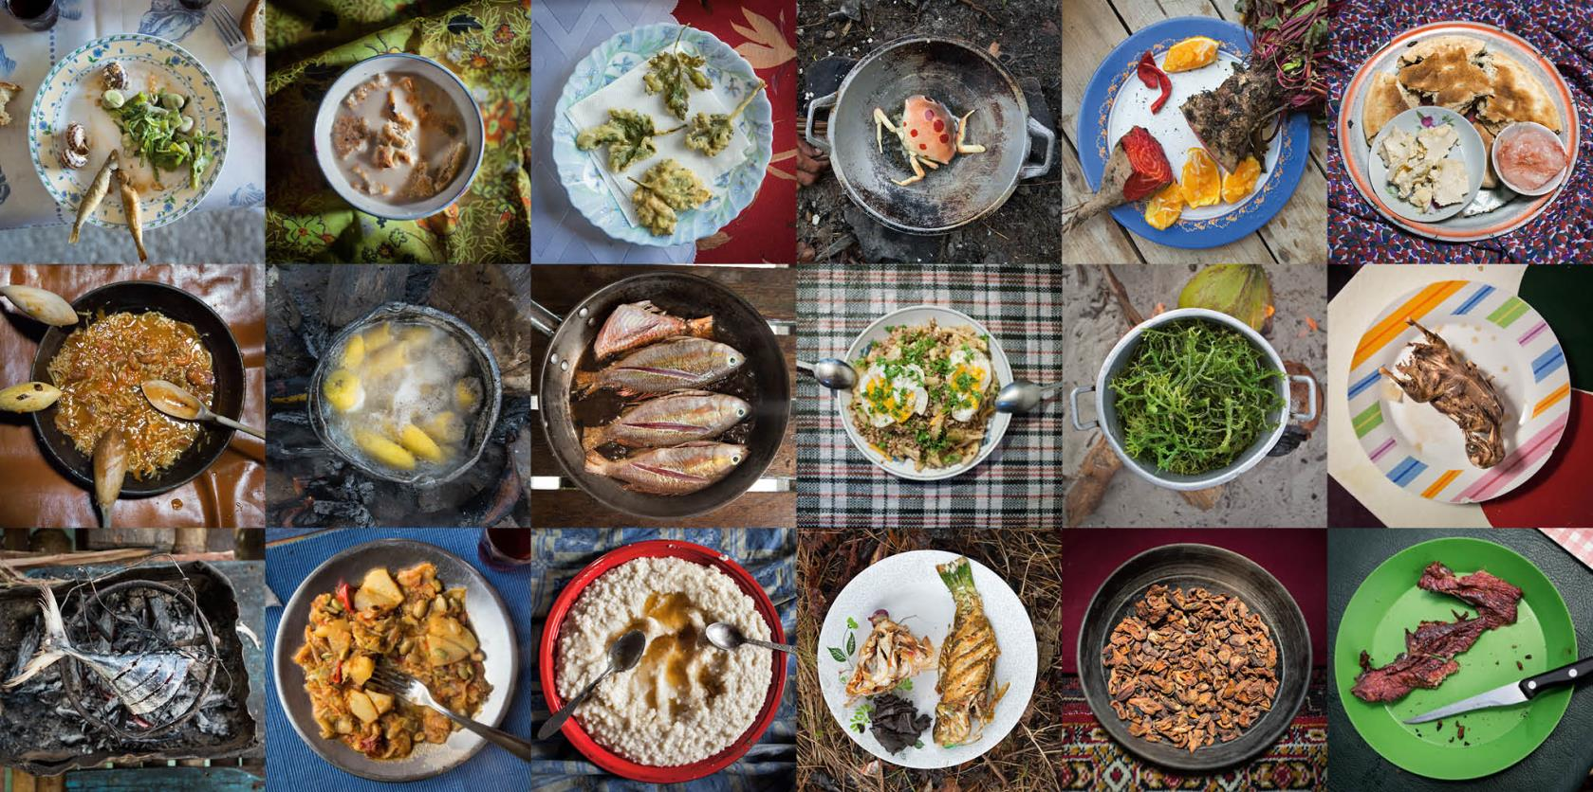
Notes:
Elevator Pitch: Tahoe Global Dish is a community pop-up dinner series featuring international cuisines not typically found in the North Lake Tahoe-Truckee region.

Slide 2
Wanna-Be Foodies
Meet your Tahoe Global Dish
Culinary Crew
Joyce Scardina Becker
Hilary Hobbs
Katelynn Hopkins
Erica Mertens
Grant Sacks
WAYS TO MY HEART:
Buy me Food
Make me Food
Be Food
Notes:
My name is Katelynn Hopkins
I work for the Placer County in the Executive Office
I am From Sacramento
I crave Swedish Waffles topped with Cloudberry Jam

Slide 3
Menu Preview
What do we have in store for you?
Why Tahoe Global Dish
In A Nutshell
Survey Says…
Target Market
Show Me The Money
Getting The Word Out
Questions
Part of the secret of success in LIFE, is to EAT what you like
- Mark Twain

Slide 4
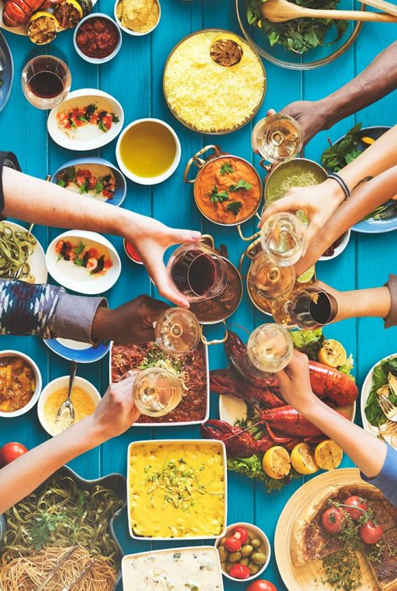
Why Tahoe Global Dish?
Satisfy your craving
Shoulder season business
Bring community together
International cuisine opens up one’s
heart, mind and palette
one bite at a time
Notes:
Bolsters shoulder season: spring/ fall

Slide 5
In A Nutshell
Rotating
Venues
Set Menu
The discovery of a NEW DISH
confers more HAPPINESS on humanity,
than the discovery of a new star.
-Jean Anthelme Brillat-Savarin
Rotating
Cuisine
Prix Fixe

Slide 6
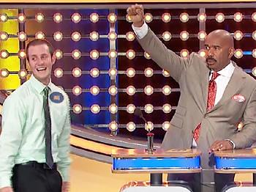
Survey Says?
Attendance
93%
55%
Thursday
Day
Location
Price Point
$25
91%
Truckee
Notes:
Survey Says!
We created a survey using Survey Monkey.
The survey was distributed though the Truckee Camber.
We received over 130 responses!
When asked how likely are you to attend Community Pop-Up Dinner Series?
93% of respondents were likely to attend and 29% “extremely likely”
Where would you be willing to travel?
91% of respondents indicated a willingness to travel to Truckee.
What day of the week would you be likely attend this event?
55% of respondents are likely to attend an event on Thursday.
What price would you be willing to pay?
The mean price point came back at $25 a ticket.

Slide 7
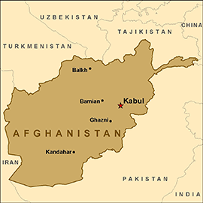
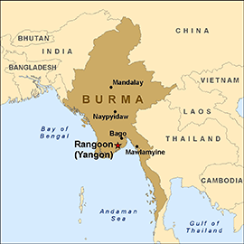
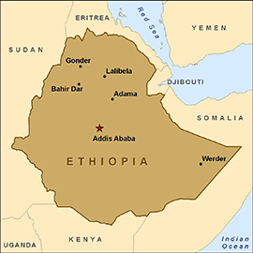
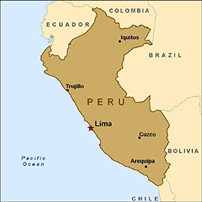
Cuisine
Which ethnic cuisine you would be most interested in experiencing at a Community Ethnic Food Night?
Notes:
Now for the survey main course…..
We asked which ethnic cuisine you would be most interested in experiencing at a Community Ethnic Food Night?
With the options of Afghani, Burmese, Ethiopian, and Peruvian.

Slide 8
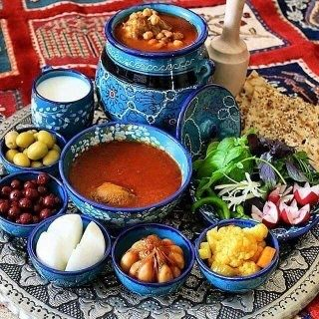
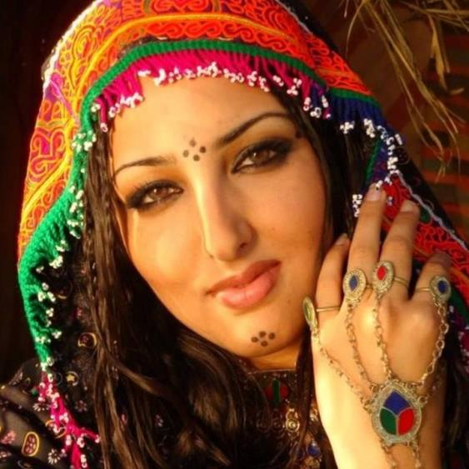
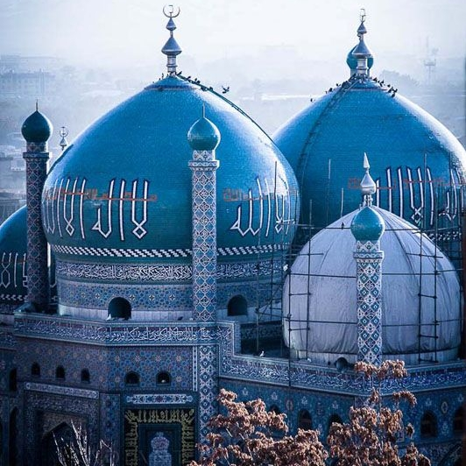
The First Stop on the Culinary Caravan… Afghanistan

Slide 9
Target Market
Adults
All age groups
Locals
Cravings international flavors
Attending with significant other or friends
Children are less likely
Nothing brings PEOPLE together like good FOOD.

Slide 10
Show Me The Money
YEAR 1 BUDGET
 | Budget
REVENUE
Ticket Proceeds, per event: (100 attendees @ $25) | $2,500
Start-up grant | $5,000
TOTAL | $7,500
EXPENSES
Venue and food cost, per event | $2,500
Digital Marketing | $1,000
Print Marketing | $1,000
Marketing collateral | $500
TOTAL | $5,000
Food is our COMMON GROUND,
a UNIVERSAL experience.
- James Beard

Slide 11
Getting Word Out
Social Media
Digital
Print
Radio
Poster
Notes:
Sponsorship possibilities

Slide 12
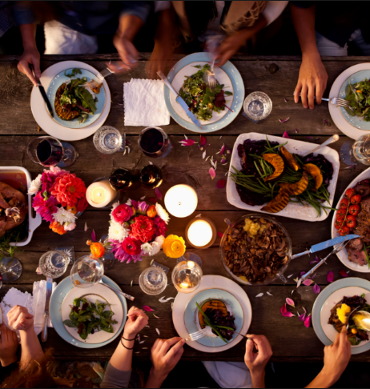
Post Nibble Questions?
You can’t buy HAPPINESS, but you can buy
BAKLAVA…and that is kind of the same thing.

